Slide 1
Introduction to UML
Object Oriented Development
with Java
(CT038-3-2 and Version VC1)
System Modeling

Slide 2
Topic & Structure of The Lesson
Usecase diagram
Class diagram
Activity diagram

Slide 3
Learning outcome
At the end of this lesson, you will be able to
Explain what is Unified Modeling Language (UML)
Define the types of processes that best relate to the UML
Types of UML diagrams

Slide 4
Key terms you must be able to use
If you have mastered this topic, you should be able to use the following terms correctly in your assessments:
--Usecase –actors,usecase,extend,include
-class- association,aggregation,composition
-activity

Slide 5
What Is the UML?
The UML is a language for
Visualizing
Specifying
Constructing
Documenting
the artifacts of a software-intensive system.

Slide 6
The UML Is a Language for Visualizing
Communicating conceptual models to others is prone to error unless everyone involved speaks the same language.
There are things about a software system you can’t understand unless you build models.
An explicit model facilitates communication.

Slide 7

The UML Is a Language for Specifying
The UML builds models that are precise, unambiguous, and complete.

Slide 8
The UML Is a Language for Constructing
UML models can be directly connected to a variety of programming languages.
Maps to Java, C++, Visual Basic, and so on
Tables in a RDBMS or persistent store in an OODBMS
Permits forward engineering
Permits reverse engineering

Slide 9
The UML Is a Language for Documenting
The UML addresses documentation of system architecture, requirements, tests, project planning, and release management.

Slide 10
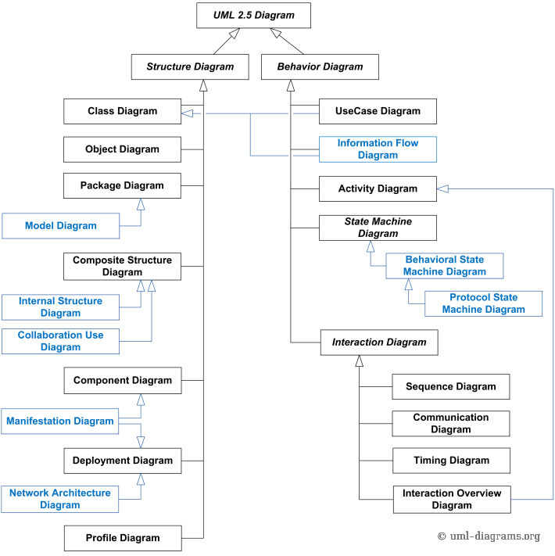
Types of UML diagrams
Our focus
Source: http://www.uml-diagrams.org/uml-25-diagrams.html

Slide 11

History of the UML
UML 2.5
(2015)
UML 2.0
(2004)
UML 1.5
(March, ‘03)
UML
Partners’
Expertise
UML 1.1
(Sept. ‘97)
UML 1.0
(Jan. ‘97)
UML 0.9
(June ‘96)
and
UML 0.91
(Oct. ‘96)
Public
Feedback
Unified Method 0.8
(OOPSLA ’95)
Booch ’93
OMT - 2
OOSE
Other
Methods
Booch ‘91
OMT - 1

Slide 12
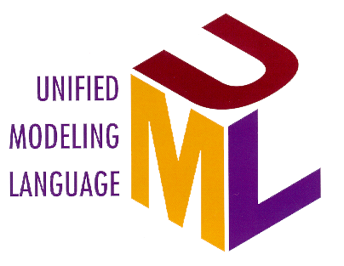
Inputs to the UML
Rumbaugh
Booch
Jacobson
Meyer
Fusion
Before and after conditions
Operation descriptions, message numbering
Harel
Embley
State charts
Singleton classes, High-level view
Gamma, et.al
Wirfs-Brock
Frameworks, patterns, notes
Responsibilities
Shlaer- Mellor
Selic, Gullekson, Ward
Odell
Object lifecycles
ROOM (Real-Time Object-Oriented Modeling)
Classification

Slide 13
What Type of Process Most Benefits the UML?
The UML is largely process independent. A process fully benefits from the UML when the process is:
Use-case driven
Architecture centric
Iterative and incremental

Slide 14
A Use-Case Driven Process
Use cases defined for a system are the basis for the entire development process.
Benefits of use cases:
Concise, simple, and understandable by a wide range of stakeholders.
Help synchronize the content of different models.
Check Balance
Customer
Withdraw Money

Slide 15
An Architecture-Centric Process
A system’s architecture is used as a primary artifact for conceptualizing, constructing, managing, and evolving the system under development.
Benefits:
Intellectual control over a project to manage its complexity and to maintain system integrity.
Effective basis for large-scale reuse.
A basis for project management.
Assistance in component-based development.

Slide 16
An Iterative and Incremental Process
Critical risks are resolved before making large investments.
Initial iterations enable early user feedback.
Testing and integration are continuous.
Objective milestones focus on the short term.
Progress is measured by assessing implementations.
Partial implementations can be deployed.

Slide 17
Iterative Development
Earliest iterations address greatest risks.
Each iteration produces an executable release, an additional increment of the system.
Each iteration includes integration and test.
Iteration 1
Iteration 2
Iteration 3
R
R
R
D
D
D
C
C
C
I
I
I
T
T
T
T I M E

Slide 18
Quick Review Questions
What is the UML? Describe each of its four benefits.
What process characteristics best fit the UML? Describe each characteristic.
What is an iteration?

Slide 19
Summary of Main Teaching Points
-UML
-Types of UML diagram
-History of UML diagram

Slide 20
Q & A

Slide 21
Next Session
-Usecase diagram

